Slide 1
Comprehensive Research Data Management
chatGPT, Dall-E and Robert Haase

Slide 2
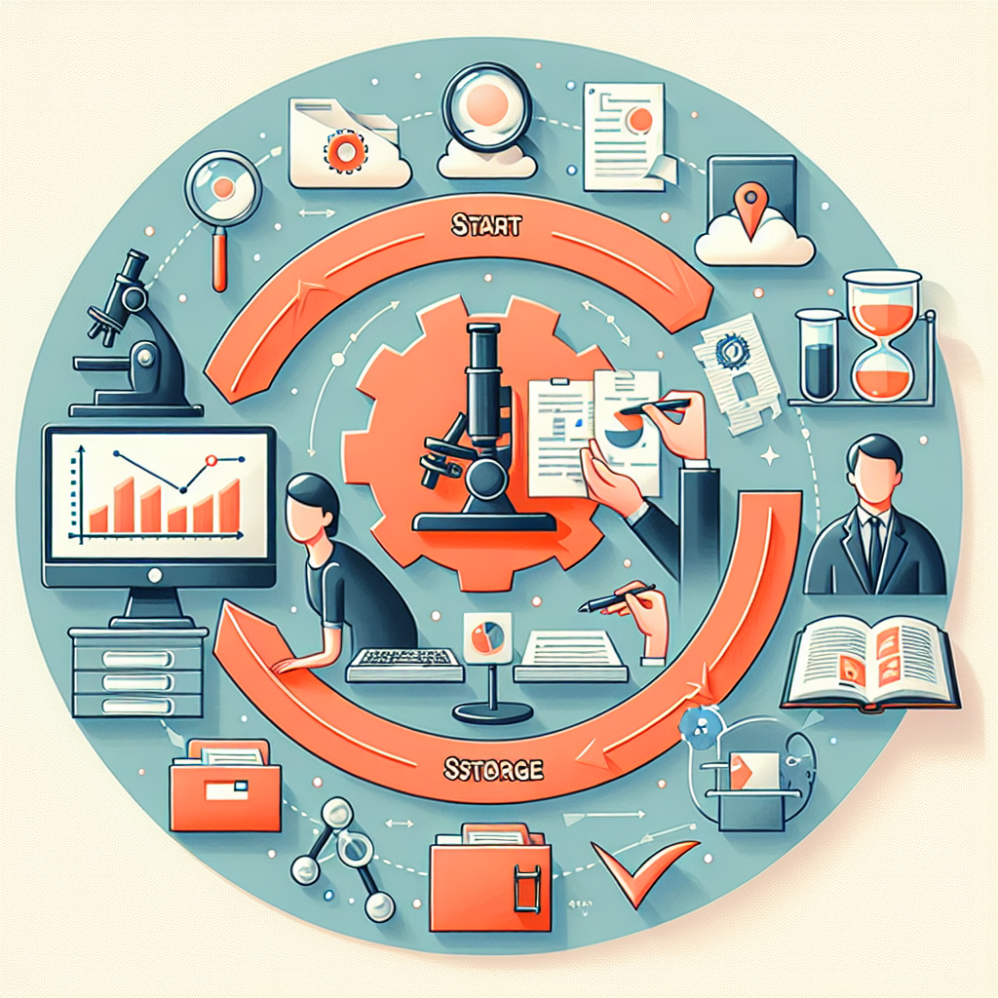
Comprehensive data management strategy.
Research Data Management (RDM) is a comprehensive approach to handling, organizing, storing, and sharing data collected or generated during a research project. It involves a range of practices throughout the lifecycle of the project to ensure that research data are efficiently managed and can be accessed both during and after the project's completion.

Slide 3
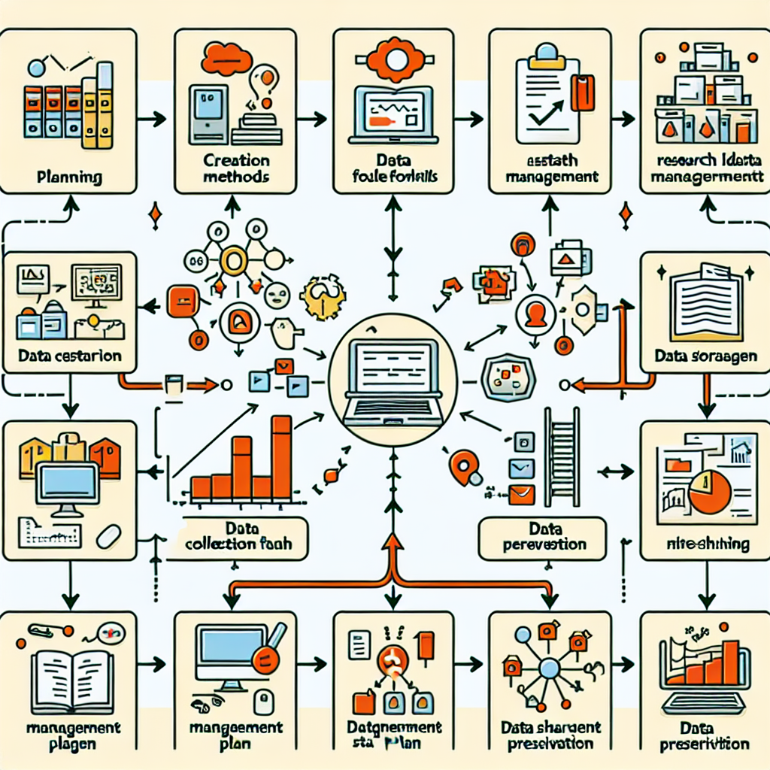
Planning Research Data Management Process.
The process of RDM usually begins with planning. This involves the creation of a data management plan (DMP) which outlines how data will be handled both during the research process and after the project is completed. The DMP addresses issues such as data collection methods, file formats, data storage, data sharing, and data preservation.

Slide 4
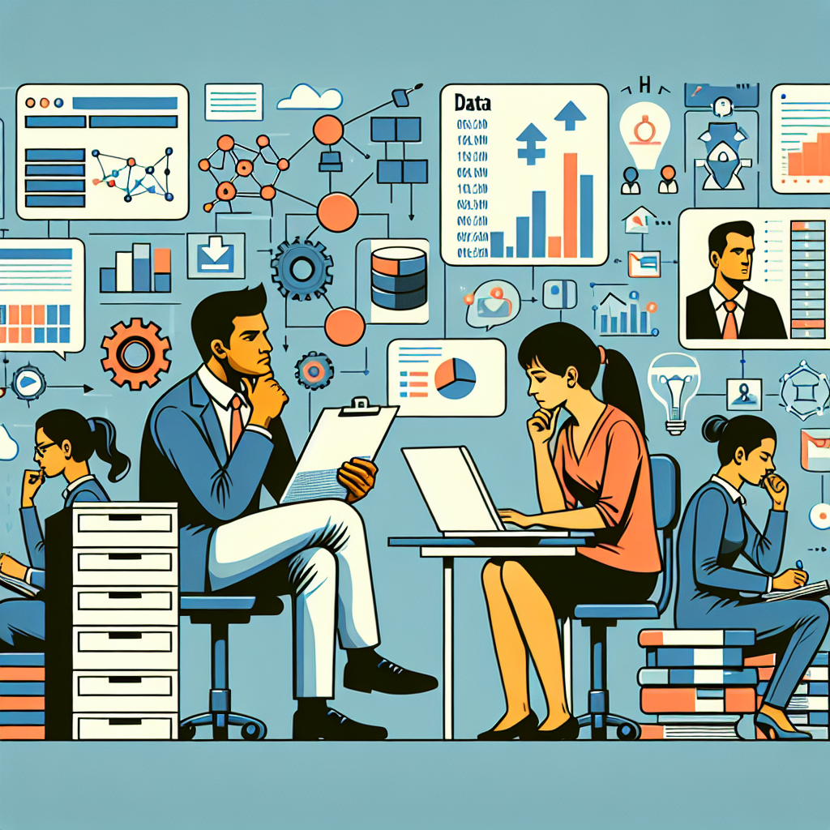
Structuring data for quality, sharing.
Data collection and creation is the next step, where researchers must consider how to structure and format their data effectively. This step is crucial for ensuring data quality and facilitating data sharing and reuse. Consistent data format and structure simplify the data analysis process and make it easier for others to understand the data.

Slide 5
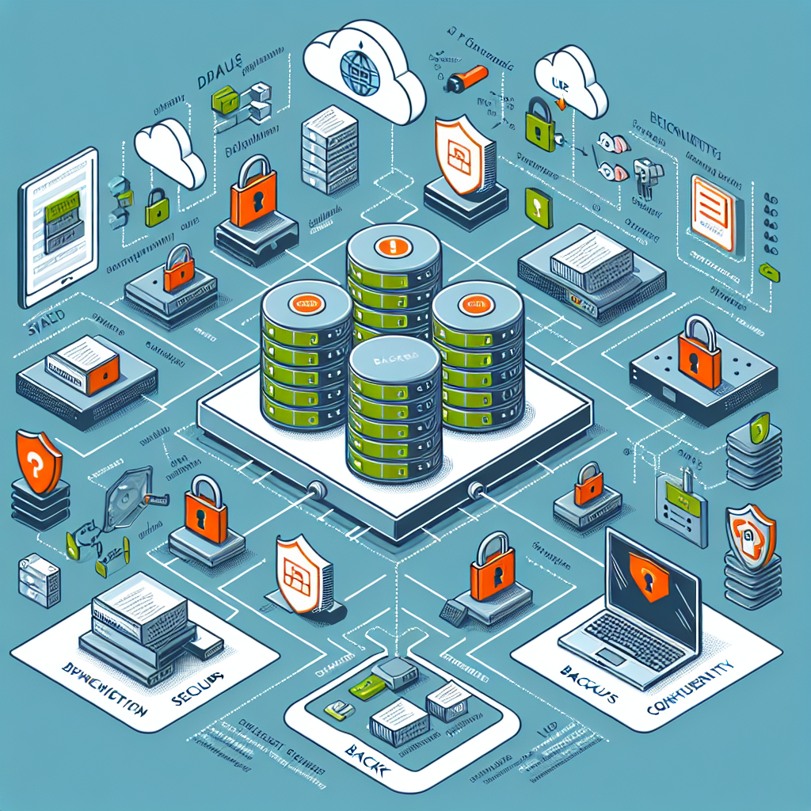
Data storage, security fundamentals crucial.
Data storage and security are also fundamental. Researchers must determine where and how their data will be stored, ensuring there are backups to prevent data loss. Equally important is ensuring the security of the data, especially if it contains sensitive or confidential information. This means implementing appropriate measures to protect data from unauthorized access.

Slide 6
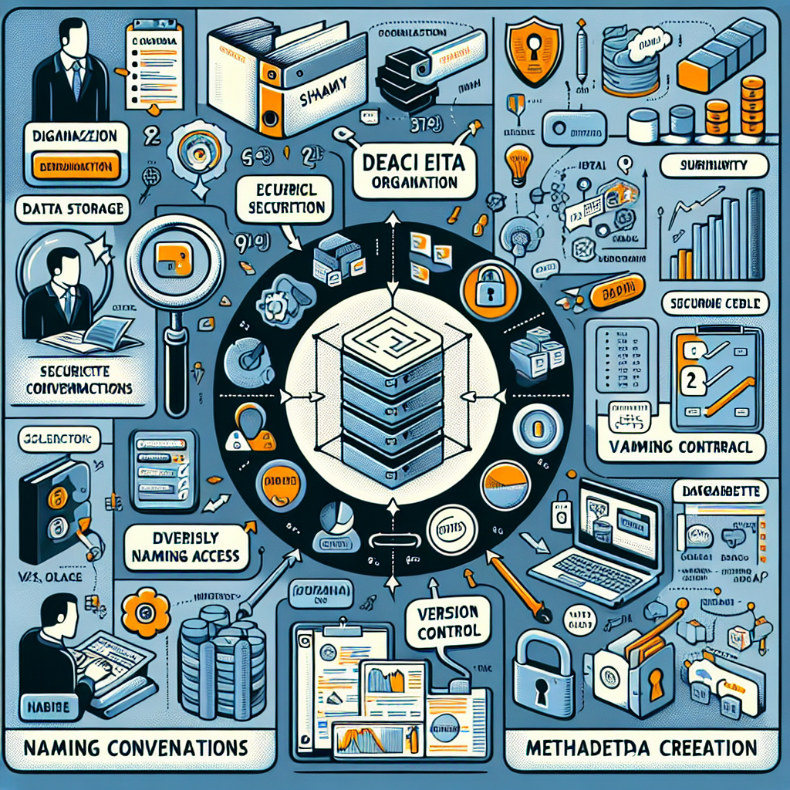
Data organization enhances security, accessibility.
Data organization goes hand in hand with storage and security. This involves naming conventions, version control, and metadata creation. Effective organization helps ensure that data can be easily located, accessed, and understood by others, including future researchers.

Slide 7
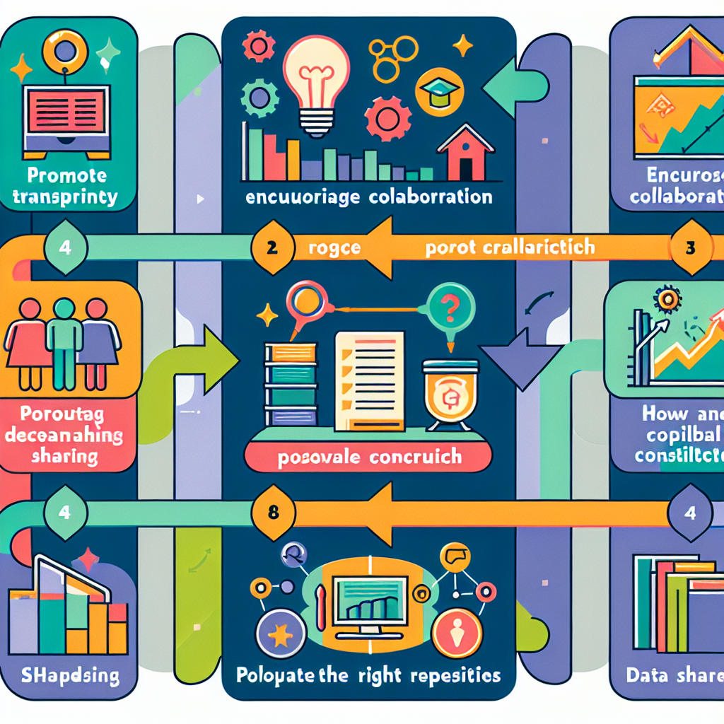
Data sharing enhances transparency, collaboration.
Data access and sharing are critical for promoting transparency, collaboration, and further research. This involves deciding how and when data will be shared, considering potential restrictions, and choosing appropriate repositories or platforms for data sharing.

Slide 8
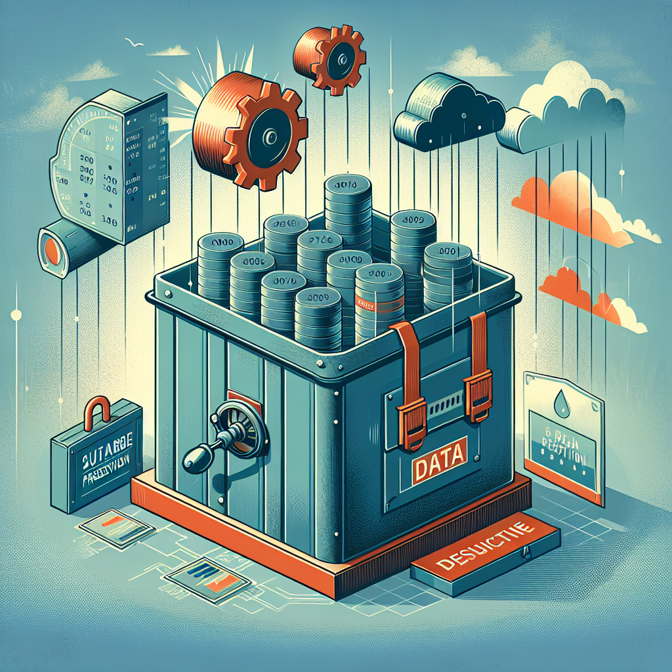
Ensuring long-term data accessibility.
Lastly, data preservation ensures that data remains accessible and usable over time. This includes selecting sustainable formats and depositing data in repositories that guarantee long-term preservation and access.

